Slide 1
CSD1401 Software Engineering Project 1
Solo Projects Introduction
Instructor
Cheng Ding Xiang
cheng.dingxiang@digipen.edu
Gerald Wong
g.wong@digipen.edu
Office Hours
By Appointment
Overview
Submissions
Goals
Notes:
15 to 30 minutes brief

Slide 2
Overview
Weeks 3 - 6

Slide 3
Weeks 3 - 6
3 Solo Projects
Splash Screen
Car Select Game (CSG)
Game Of Life (GOL)
Build up individual foundation

Slide 4
Splash Screen

Slide 5

Splash Screen

Slide 6
Requirements (Splash Screen)
Functionally needs to follow what you see in this video and the sample executable file
Background image that fades in repeatedly in 2 second intervals
Red circle that follows the position of the mouse cursor

Slide 7
Car Select Game
CSG

Slide 8
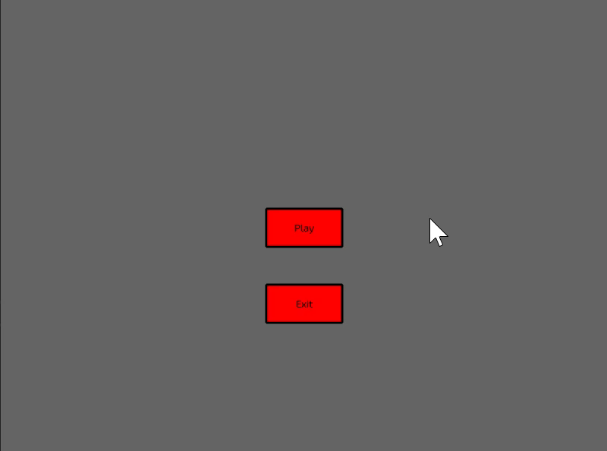
Car Select Game

Slide 9
Requirements (CSG)
Functionally needs to follow what you see in this video and the sample executable file
Two states : Main Menu and Car Select

Slide 10
Requirements (CSG)
Main Menu (State)
One button to go into the Car Select (State)
Another button to quit the application
These buttons respond to mouse click input within the boundaries of the button

Slide 11
Requirements (CSG)
Car Select (State)
Click on a car to select it
Upon selection:
Car can rotate with “D” and “A” Key press
Car can move towards and away from facing direction with “W” and “S” Key press respectively
“Q” Key press returns user to Main Menu (state)

Slide 12
The Game of Life

Slide 13
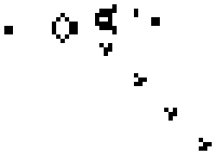
The Game Of Life

Slide 14
The Game Of Life
By John Horton Conway
Not really a game, it’s a cellular automaton
A simulation of the life and death cycle

Slide 15
The Game Of Life
From one generation to the next:
Any LIVE cell with 2 or 3 LIVE neighbours survives
Any DEAD cell with 3 LIVE neighbours become a LIVE cell
All other LIVE cells die in the next generation, All other DEAD cells stay dead

Slide 16
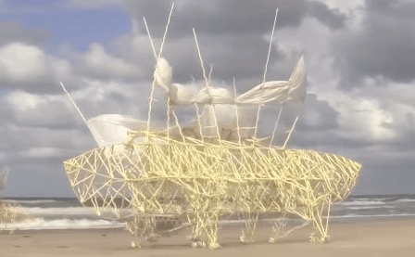
Other automaton example
Theo Jansen : Strandbeest

Slide 17
Requirements
Functionally, needs to work like this :
https://playgameoflife.com/

Slide 18
Requirements
Input
Mouse input to toggle cells between LIVE and DEAD states during “Pause” state
Input options for “Pause” and “Play” state transitions

Slide 19
Requirements
Rendering
Grid lines drawn for easy viewing of individual cells
LIVE and DEAD cells easily seen and distinguishable
Something to indicate the “Pause” and “Play” state, e.g. Button display, text, overall change in colour scheme etc.

Slide 20
Requirements
Simulation Logic
Any LIVE cell with 2 or 3 LIVE neighbours survives
Any DEAD cell with 3 LIVE neighbours become a LIVE cell
All other LIVE cells die in the next generation, All other DEAD cells stay dead

Slide 21
Requirements
“Play” State
Runs the Simulation Logic
Has an input option to go into the “Pause” state
No input options to edit cells in the grid

Slide 22
Requirements
“Pause” State
Pauses the simulation
Allows user to edit cells in the grid
Has an input option to go into the “Play” State

Slide 23
Submissions

Slide 24
Submissions
Code submitted to be free from errors and warnings when compiling
Code should not lead the program to crash
Naming conventions and formats of all deliverables must adhere to stated requirements

Slide 25
Submissions
There will be 3 Submission to take note of
Splash Screen, Week 3 Sunday 2359H
Car Select Game, Week 5 Sunday 2359H
Game of Life, Week 6 Sunday 2359H
Splash Screen does NOT contribute to your final grade of the class.
Splash Screen acts as feedback to Lecturers to identify who needs help

Slide 26
Submissions
Car Select Game, Week 5 Sunday 2359H
Game of Life, Week 6 Sunday 2359H
Midterm Submissions, 30% of your final grade
Failing these submissions, means failing the course

Slide 27
Goals

Slide 28
Goals
Technical Learnings
Game loop
Reading and processing input
Basic Rendering
Logic and algorithm implementation
Intersection tests
Movement
Functions
Arrays
Structures

Slide 29
Goals
Production Learnings
Task priority and sequencing
Time management
Workload estimation
Meeting deadlines

Slide 30
Every Week (weeks 3 - 6)
Before Lab – at least read the handout given
One handout to read for weeks 3,4,5
Best case is that you have already started working on the milestone

Slide 31
The Plan
Week | Project | Lesson | Milestone
3 | Splash Screen Given | Basic Rendering Game Loop Interpolation | Splash screen fades in every 2 seconds. A rendered shape follows mouse position.
4 | Car Select Game (CSG) given | Mouse input Static Intersection Movement Multiple objects 1D Arrays | Have a main menu with buttons. One button goes into a game where cars can be chosen and driven.
5 | Game of Life (GOL) given CSG due (Sun 2359h) | Animation 2D Arrays Logic and States | Game of Life grid drawn, with the life cycle simulation working.
6 | GOL due (Sun 2359h) | Production Planning and presentation | Addition of Pause state that allows editing of LIVE and DEAD cells.

Slide 32
Every Week (weeks 3 - 6)
During Lab
Lecturers and TAs are available to help
Focus your time and attention to complete requirements for the week
Do your best to finish weekly milestones within lab time
Best case, starting on the next milestone

Slide 33
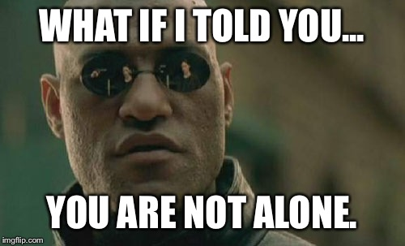
Every Week (weeks 3 - 6)
After Lab
Seek help from TAs, lecturers and classmates if you are still stuck

Slide 34
Every Week (weeks 3 - 6)
Reflect
How long it took you to accomplish the milestone
What are the most effective sources of help for you
What are your most effective working hours

Slide 35
Every Week (weeks 3 - 6)
Reflect
Requirements of each milestone is clear
How clear are the requirements you set for your own project?
What else do you need for your own project?

